Slide 1
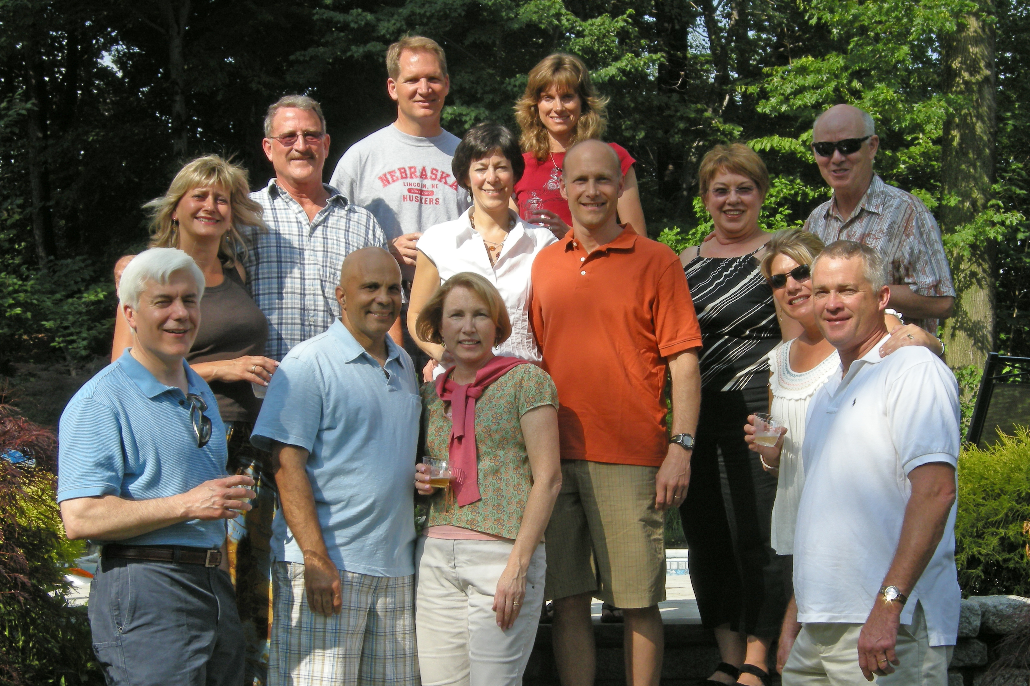
MEFC Transition Plan
17 years of God’s Leading

Slide 2
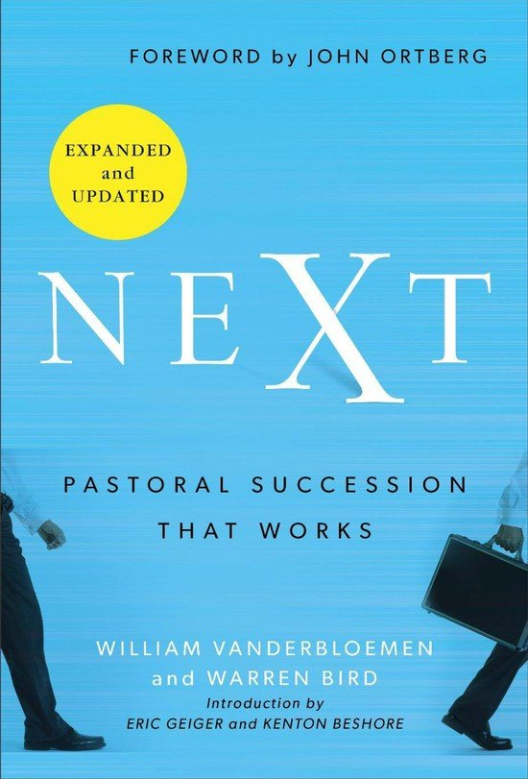
NEXT by Vanderbloemen and Bird

Slide 3
Timeline – Up to Today
Elders and Pastors (March `24 – August `24)
Pastor Sam announced his retirement to the Elders (March 8, 2024)
Reading Next on Succession Planning
Prayer Sheet developed
Overall positive transition with Pastor Chris Helding – Chemistry Staffing (recruiter), etc.
Senior Pastor’s Final Year (Sept `24 – August `25)
Pastor Sam creates a retirement plan letter (complete)
Elders create a succession plan (Fall 2024)
  Discussions with Interim Pastor Ministries (IPM)
  Discussions with Chemistry Staffing
Senior Pastor’s letter is sent out to the congregation (January `25)
Elder’s share succession plan document with congregation (January `25)

Slide 4
Timeline – Going Forward
Senior Pastor search committee (by MEFC constitution) is formed (by year end `25)
Search committee and interim pastor will develop candidate search criteria and then engage with Chemistry Staffing (January `26)
Chemistry Staffing presents 2 – 3 candidates for consideration (approximately 3 - 5 months after beginning the search)
Candidate Weekend for potential new Senior Pastor (late Spring `26)
New Senior Pastor moves to Montvale (Summer `26)
Engage services of IPM in advance of Senior Pastor’s departure (April `25)
Call and elect Search Committee (April `25)
Interim Pastor Introduction Weekend (June/July `25)
Celebrate Pastor Sam and Andrea’s Service and Retirement Plans (late Spring `25)
Pastor Sam vacates parsonage (August`25)
Transition Year (Sept `25 – August `26)
Interim Pastor works with Elders, pastors, and the congregation for health assessment and vision (Fall `25)

Slide 5
Why an Interim Pastor?
Time: An interim pastor allows time to find the right man of God to lead us at Montvale.
Stability: An interim pastor does everything that Pastor Sam does today, not only filling the pulpit on Sundays, but allowing the staff to continue to do their jobs well.
Direction: The interim can help us assess our current ministry and help develop where Montvale should head in the coming years. Also assists the Search Committee in defining the qualities needed for our Next Senior Pastor. This is done through your input!

Slide 6
Brief Explanation about the Interim Pastor (IP)
1. The interim is NOT available to become the new Senior Pastor. The average age is 63 and these men are specifically trained, and receive ongoing coaching in how to lead a church through this interim period.
2. The interim is contracted for 3 months initially with IPM (not us), then on a month-by-month basis afterwards to avoid any conflict with timing for the hiring of the New Senior Pastor.
3. IPM is funded by the current compensation package for Pastor Sam. There are only some incidental initial upfront costs for IPM to identify the proper fit with MEFC.
4. We work with IPM to select the interim pastor. Like our other pastoral hires, the potential interim comes for a introduction weekend before any final decisions by the Elders.
5. Even once the interim is in place, we can work with IPM if we feel the fit is not right. While extremely uncommon, it does provide greater flexibility.

Slide 7
5 Key Steps During the Interim Pastoral Stage
Connect With People
Assess Church Health
Facilitate Action
Lead Strategic Planning
Coach Search Committee

Slide 8
Why Do We Need a Search Firm?
Broader Reach: Search firms have extensive networks within the pastoral community, allowing them to identify potential candidates that a church might not find on their own. Pastors seeking new opportunities connect with these firms.
Expertise in assessment: Pastoral search companies are skilled in evaluating candidates' theological beliefs, leadership style, and compatibility with the church culture, going beyond just reviewing resumes.
Confidentiality: A search firm can discreetly manage the process, protecting the privacy of both the church and potential candidates.
Efficient process: Search companies streamline the selection process by managing applications, conducting initial interviews, and presenting a curated list of qualified candidates to the church committee.
Guidance and support: They can advise the church on best practices for the search, including developing a clear job description, managing communication, and navigating the transition process.

Slide 9

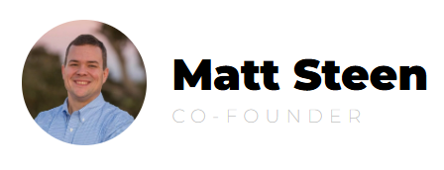
Chemistry Staffing
Church Expertise: Chemistry only serves the church community and is able to market the position and screen candidates far more quickly and thoroughly. They focus on five values: theology, culture, personality, skills and abilities, and chemistry
Know the Northeast: Co-founder Matt Steen served at Pascack Bible church and our own Chet Klope assists in screening candidates for Chemistry.
Cost Effective: Chemistry is sized and priced to serve a church the size of Montvale

Slide 10
Questions

